Slide 1
Hybrid Algorithm for Dynamic Ranking Management
Hengcheng Zhang
25/6/2024

Slide 2
Algorithm Overview
Question: How to efficiently update player ranking scores in real time?
Goal:
1.Insert new scores efficiently and keep the list ordered.
2. Ensure efficiency even when dealing with large amounts of data.
Solution: Use a hybrid algorithm of binary search and insertion sort to solve the specific problem of dynamic ranking management.
Why use binary search and insertion sort?
The time complexity of binary search is O(logn), which is highly efficient and suitable for scenarios with frequent insertions.
Insert new elements into the correct position of the sorted part, keep the array ordered by moving elements, and it is suitable for dynamic update scenarios.

Slide 3
Implementation of binary search
1.The core of binary insertion sort is to quickly find the insertion position through binary search
2. Binary search reduces the time complexity of finding the insertion position from linear O(n) to logarithmic O(logn) therefore, hybrid algorithms can be more efficient when processing large amounts of data.

Slide 4
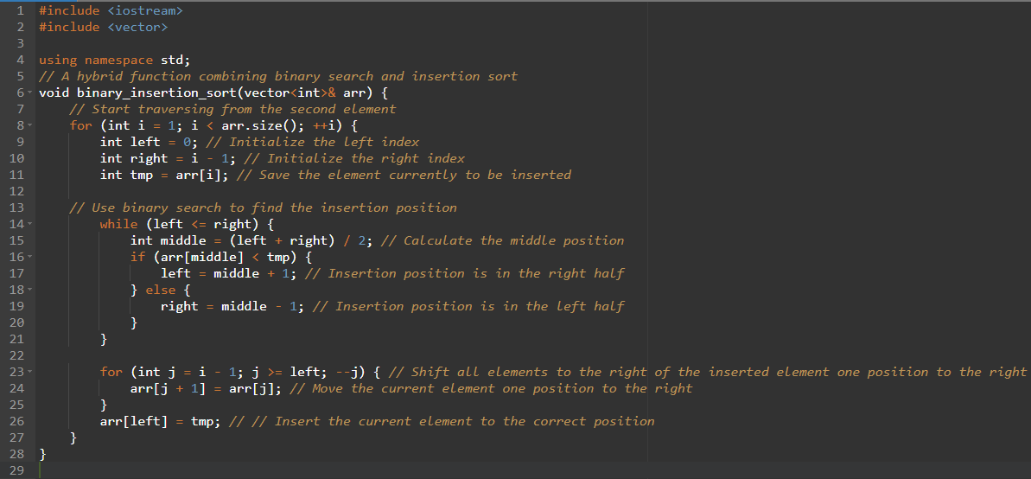
Implementation of hybrid algorithm

Slide 5
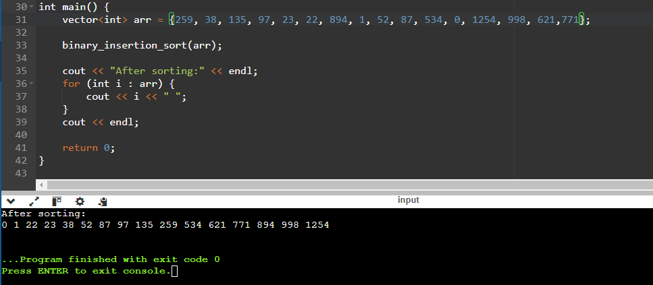
Example Run and Summary
The hybrid algorithm of binary search and insertion sort can effectively solve the problem of dynamic ranking update.
The insertion efficiency is improved and the hybrid algorithm is suitable for scenarios where ranking scores are updated in real time.

